Slide 1
Git & GitHub

Slide 2
What is Git?
Git is a version control system that helps developers track changes, manage code, and collaborate on projects easily and securely.
Version Control System: Git tracks changes to files and code over time.
Distributed System: Each developer has a full copy of the project’s history on their local machine, so there’s no single point of failure.
Branching and Merging: Git allows you to create separate branches for features or fixes, test them independently, and then merge when ready.
Change History: Every change is saved with details about who made it and when, making it easy to review and revert if needed.

Slide 3
What is Git?
Collaboration Tool: Git supports teamwork by letting multiple people work on the same code without conflicts.
Open Source: Git is free and widely used, with a strong community for support.

Slide 4
Why is Git Important?
Collaboration: Git allows developers to work together smoothly without overwriting each other’s work.
Change Tracking: Every edit is recorded, so you can review past changes or restore old versions if necessary.
Experimentation: Branching allows for safe testing of new features or bug fixes without affecting the main codebase.
Backup: By pushing code to a remote repository, Git keeps your work safe, even if your local machine fails.

Slide 5
Why is Git Important?
Transparency: Logs show who made each change, providing a clear history and accountability.
Industry Standard: Git is widely used, making it a must-have skill for developers and essential in today’s software workflows.

Slide 6
Difference Between Main Branch and Master Branch
Master: Traditionally used as the default branch name in Git repositories.
Main: Adopted as the new default branch name in many platforms, including GitHub, to be more inclusive.

Slide 7
Difference Between Git and GitHub
Git:
A version control system used to track changes in code and files.
Works locally on your machine.
GitHub:
A cloud-based platform that hosts Git repositories.
Allows collaboration, sharing, and managing projects with others online.

Slide 8
How do you create a new repository on GitHub?
Here are the steps to create a new repository on GitHub:
Log in to your GitHub account at GitHub.com.
2. Click the '+' icon in the top right corner.
3. Select "New repository" from the dropdown menu.
4. Enter a name for your repository.
5. Optionally, add a description.
6. Choose the repository's visibility (Public or Private).

Slide 9
How do you create a new repository on GitHub?
7. Optionally, check "Initialize this repository with a README."
8. Click the green "Create repository" button.

Slide 10
Difference Between Local and Remote Repository
Local Repository:
Stored on your own computer.
Allows you to make changes and commit without internet access.
Contains the entire project history, including all versions of files.
Great for individual work and testing changes before pushing to a remote.

Slide 11
Difference Between Local and Remote Repository
Remote Repository:
Hosted on a server (like GitHub, GitLab, or Bitbucket).
Accessible over the internet, allowing collaboration with others.
Acts as a central backup for your project.
Used to share your code and work with a team.

Slide 12
How to Connect Local to Remote Repository
1. Create a Remote Repository: Create a new repository on GitHub or another platform.
2. Open Terminal: Navigate to your local project folder using the command line.
3. Initialize Git (if not already done): git init
4. Add Remote Repository: Use the command below, replacing <URL> with your
remote repository’s URL: git remote add origin <URL>
5. Verify the Connection: To check if the remote was added correctly, run:
git remote -v

Slide 13
How to Connect Local to Remote Repository
6. Push to Remote: Finally, push your local changes to the remote repository:
git push -u origin main
(Replace main with the appropriate branch name if necessary.)
Now, your local repository is connected to the remote repository!

Slide 14

Task 1: Set Your User Name and Email Address in Git
To set your user name and email address in Git, follow these steps:
Set Your User Name: Enter the following command, replacing "Your Name“ with your actual name:
git config --global user.name "Your Name”
2. Set Your Email Address: Enter the following command, replacing “ email@example.com" with your actual email address: git config --global user.email your_email@example.com
3. Verify Your Settings: To check if your settings have been saved correctly, run: git config --global --list
This will display your user name and email address along with other configuration settings.
Now your user name and email address are set up in Git, and they will be associated with your commits!
After complete the configuration we have to start below process.

Slide 15
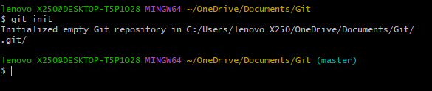

Git Init
Git Init: This command sets up a new Git repository in the current directory, allowing you to start version controlling your project.
Firstly, we have to give git init command in git bash. It will initialize the empty repository as .git in our folder.
Syntax: git init

Slide 16
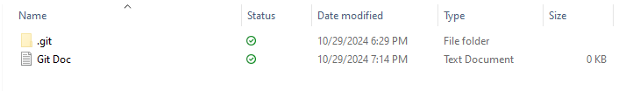
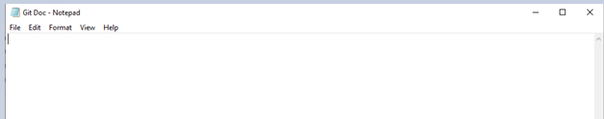
In this folder we have to add empty text document and give a name to that text document as Git Doc

Slide 17
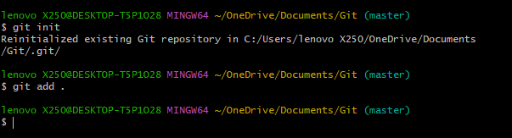
Git Add
Git Add: The git add command is used to stage changes in your working directory for the next commit in a Git repository.
Syntax: git add .
After creating Git Doc we can give git add . command in git bash

Slide 18
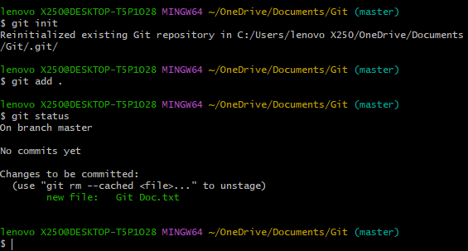
Git Status
After giving git add command we have to check git status whether the document added or not.
Git status: The git status command is
used to display the state of the working
directory.
Syntax: git status
After giving git status command it shows which changes have been staged, which changes are in the working directory, and which files aren't being tracked by Git.

Slide 19
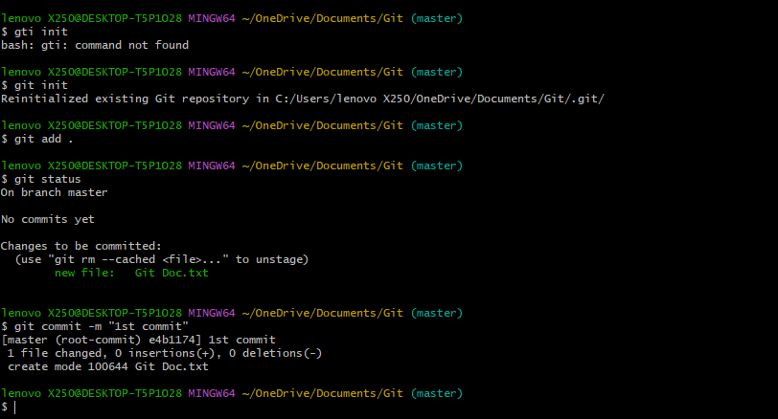
Git Commit
Git commit: The git commit command is used to save changes to the local repository. Below is the git commit command.
Syntax: git commit -m “commit message name”

Slide 20
After giving git commit command it will adding commits keep track of our progress and changes as we work.
Git considers each commit change point or save point
It is a point in the project you can go back to if you find any type of error, or want to make a change.
When we commit, we should always include a message.
By adding clear messages to each commit, it is easy to see what we have changed and when will be changed.

Slide 21
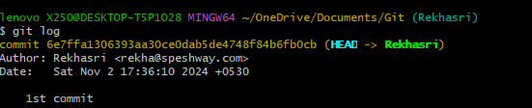
Git Log
Git log: The git log command is used to view the commit history of a Git repository.
Syntax: git log
After giving git log command we have to see all the commits what we have done.
After committing this, we have to some content in Git Doc after adding content we have to save that file and again we have to add in git.
After giving git add . command again we have to commit and check status as shown below

Slide 22
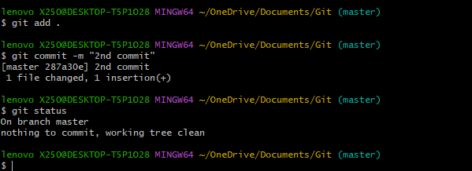

Slide 23
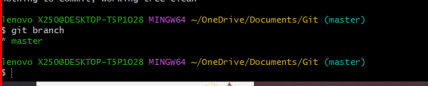
Git Branch
Git Branch: The git branch command is used to manage branches in a Git repository.
Syntax: git branch
After giving git branch command we’ve seen that how many branches are there in our git repository.
Git branch <branch name>: git branch <branch name> command is used to create a new branch with the name what we are provide.

Slide 24

Git Branch
. Syntax: git branch <branch name>
Here, in above image git branch new command, in this command we have created a new branch i.e. new.
After creating new branch, we have to check whether new branch created or not. So, we have to give git branch command to see the branch list how many branches are we’re created.

Slide 25
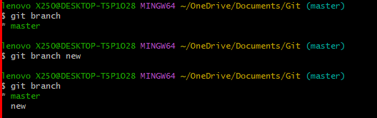

Slide 26
Git Checkout
. Git checkout: The git checkout command is used to have lets you navigate between the branches created by git branch.
In above process we have to create a new branch name as new, in this time we have to switch master branch to new branch.
Syntax: git checkout <branch name>
Git checkout -b new-branch-name: This command is used to creates a new branch and immediately switches to it.
Syntax: git checkout -b <new-branch-name>

Slide 27
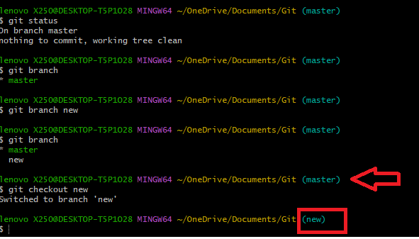

Slide 28

Git Remote
Git Remote: The git remote add origin command is used to connect your local git repository to a remote repository.
Syntax: git remote add origin <remote-repository-URL>

Slide 29
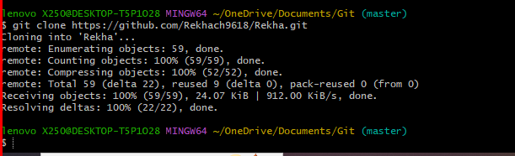
Git Clone
Git clone: The git clone command is used to create a copy of a remote Git repository on your local machine. This is typically the first step in working with an existing project that is hosted on platforms like GitHub.
Syntax: git clone <repository-url>

Slide 30
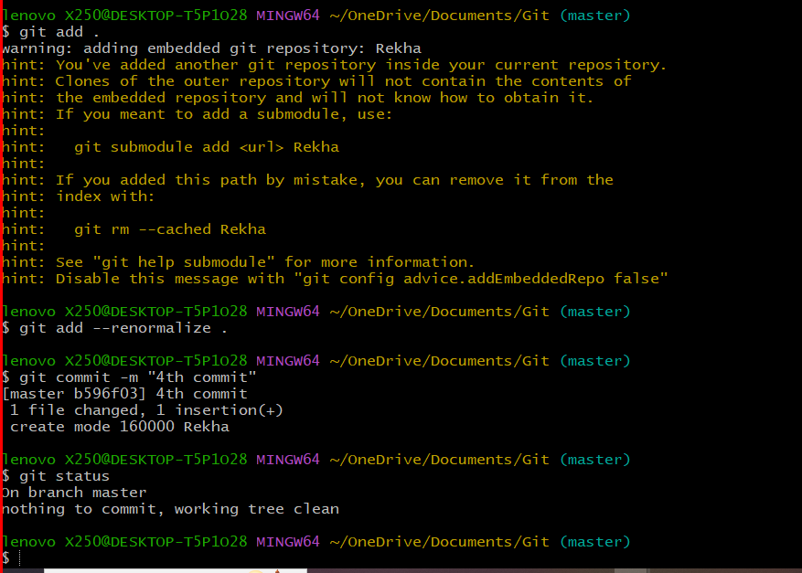
After cloning to GitHub repository, we have added cloning files into git local repository, so we have to give git add command.

Slide 31
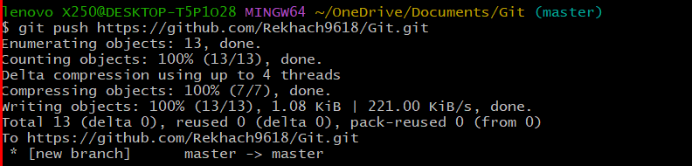
Git Push
Git Push: The git push command is used to upload your local commits to a remote repository. This command transfers your changes from your local branch to a corresponding branch on the remote repository.
Syntax: git push <remote repository URL>

Slide 32
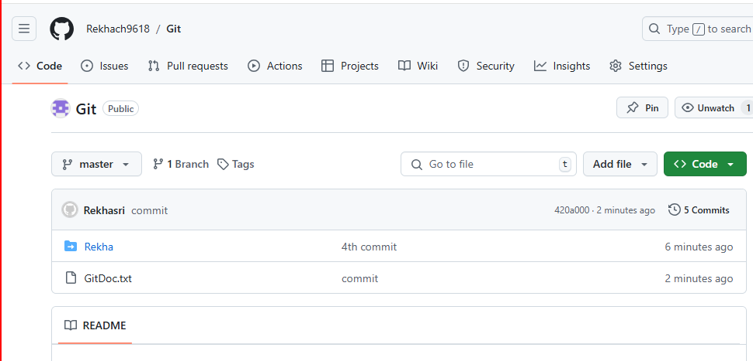
After pushing the local repository to remote repository, we have check whether our files are added or not to the remote repository in GitHub.
In below image, we have seen GitDoc.txt file in git hub what we have push local repository to remote repository

Slide 33
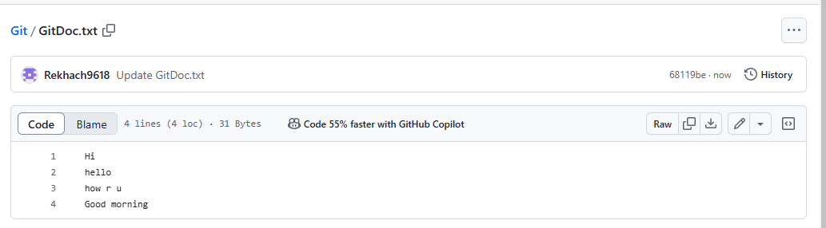
In below image we have to seen which content we are added in GitDoc.txt file

Slide 34
Git Pull
Git pull: This command fetches changes from a remote repository and merges them into your current branch.
The command git pull origin master is used to update your local repository by fetching and merging changes from the master branch of the remote repository named origin.
Here 'origin' is the name of the remote repository to get the changes from
Syntax: git pull origin master

Slide 35
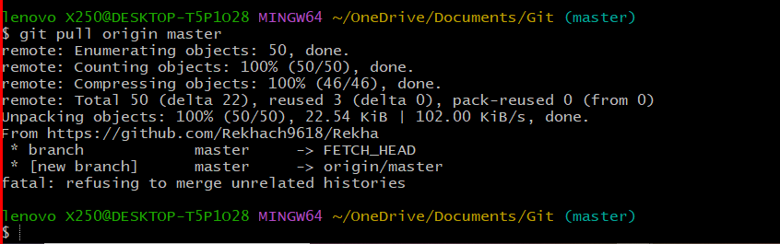
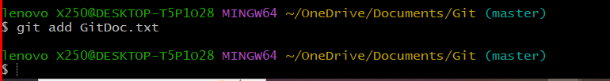
After giving git pull command again we have to git add command for stage changes in your Git repository.

Slide 36
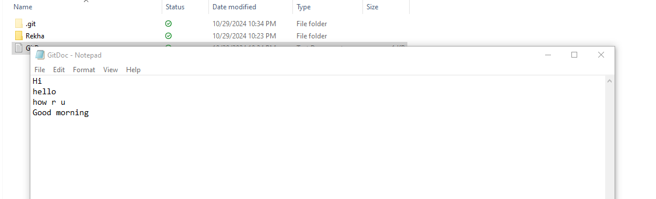
After giving git pull command again we have to git add command for stage changes in your Git repository.
In above process what we have learn is how to create a new file, how to add, how to commit, how to push local to remote repository and how to pull remote to local repository.

Slide 37
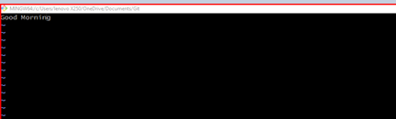
And again, we have started a new process that is git merge. In this we have to create editor file in master branch and give it to a name.
In below image we have create file as file1.txt using the command vi file.txt
After giving this command it will automatically open an editor file and in that we have to add some content in insert mode so we have to give “I” and after that add the content like below.

Slide 38
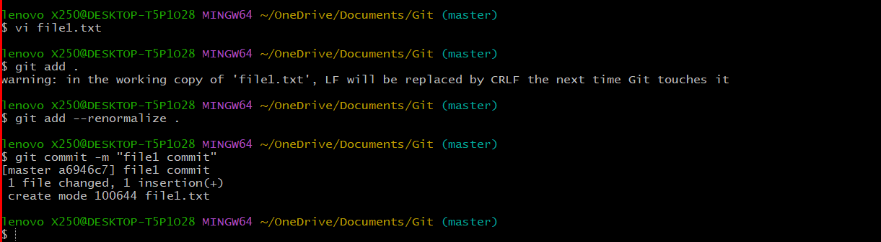
After adding some content we have to save and exit the editor file by using the command of “: wq”.
After adding the content, we need to add it. In file adding process any type of error can be occurred in the meanwhile, we have to renormalized it.
Git add –renormalize: The command git add --renormalize is used to normalize line endings and whitespace in files that are already tracked by Git. After renormalize then you will do git commit and check status.
Syntax: git add --renormalize .
Give git branch command to check branch list and select one branch and switch to it by using git checkout command

Slide 39
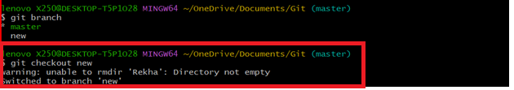
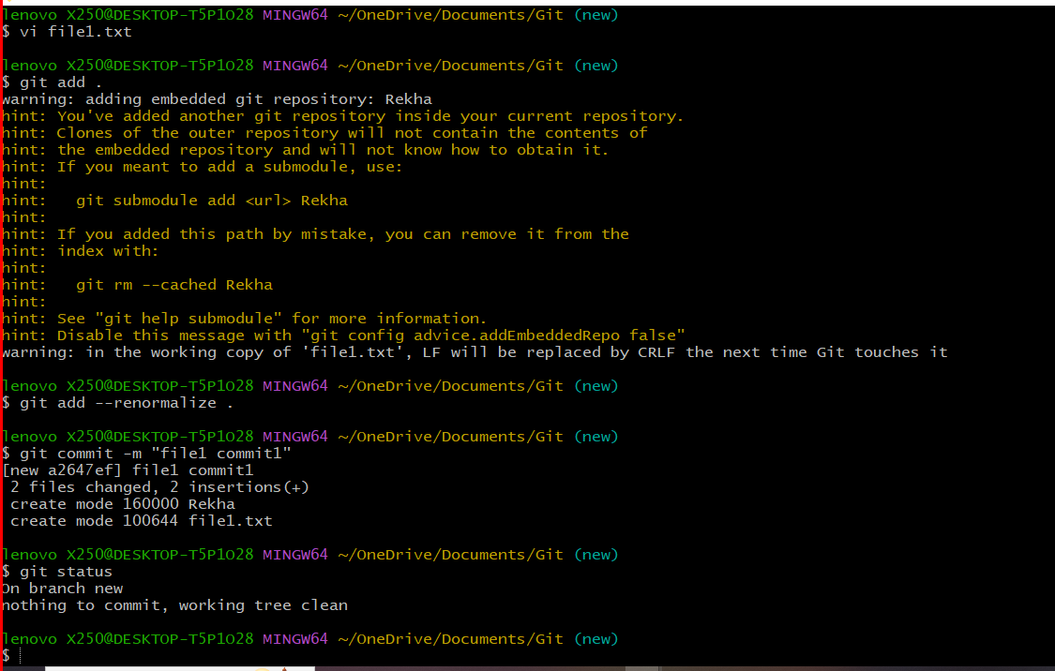
After switching the branch, we have given vi file1.txt again and add some content and add it to the repository and commit the changes.

Slide 40
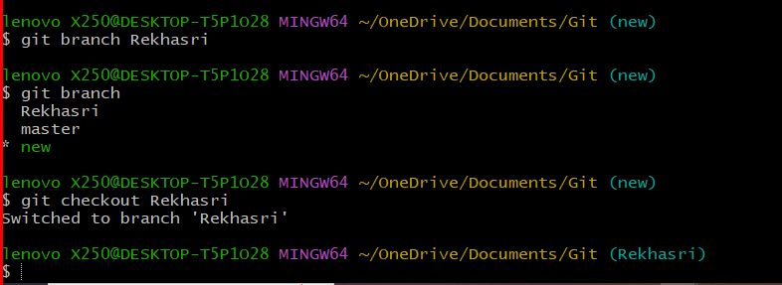
After commit we have to check status and again we have to create new branch i.e. Rekhasri and give it to git branch command for list of branches what we have to create.
After creating new branch again switch to that new branch i.e. Rekhasri by using checkout command.
After switching to new branch, we have to merge two branches by using git merge command

Slide 41
Git Merge
Git merge: The git merge command is used to integrate changes from one branch into another branch within a Git repository.
Syntax: git merge
After giving merge command we are again adding some content to vi file1.txt. after that we are switching another branch i.e. new
In the meanwhile, we get conflict as shown below image

Slide 42
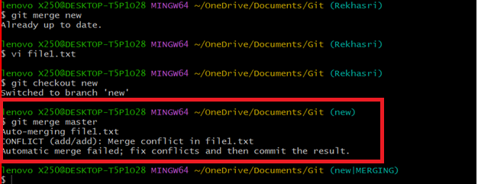
In that time, we have observed new thing will be added in the branch section i.e. MERGING. If where time conflict will be occurred MERGING will be added.

Slide 43
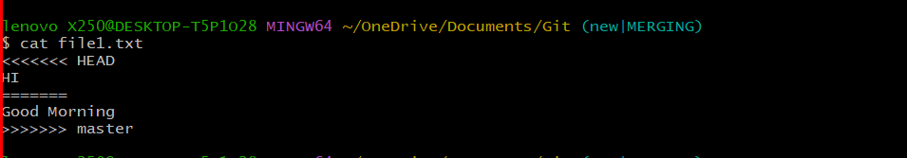
Cat
Cat command: The command cat file1.txt is used in the terminal to display the contents of a file named file1.txt.
Syntax: cat filename.txt

Slide 44
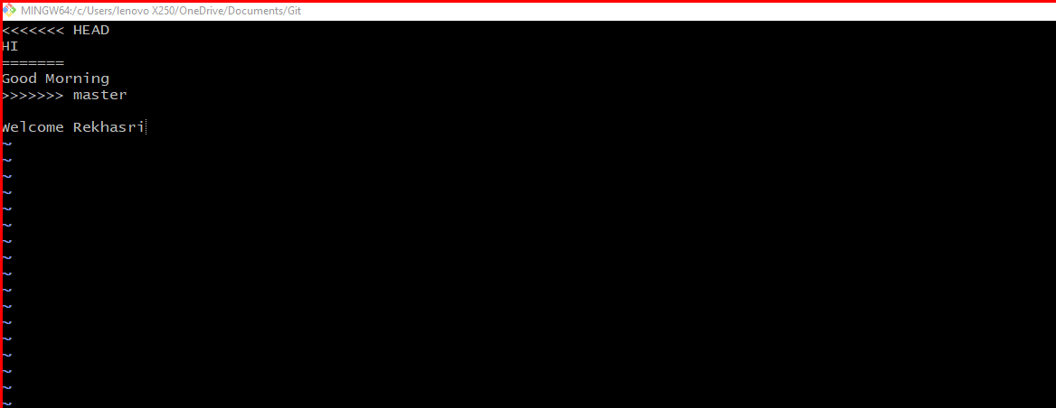
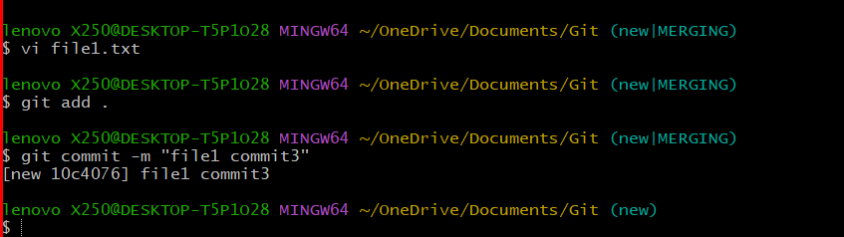
After merging we have to open vi file1.txt file, then we have to see the difference of merging conflict. Here we have to seen in below image.

Slide 45
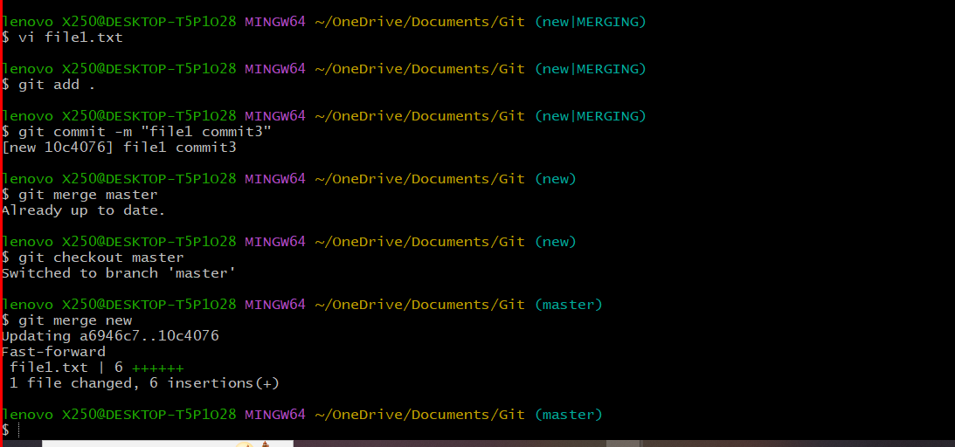
Again, give git add command and commit it for what we have seen changes in vi file1.txt. After committing this the MERGING conflict will be disappearing.
Again, merge one branch to another branch (new to master branch) by using git merge command.
Switch to master branch by using git checkout master command
After switching master branch again merge with new branch by using merge command. And after that give cat command to see the output (master branch vi file1.txt file content merging with new branch vi file1.txt file).

Slide 46
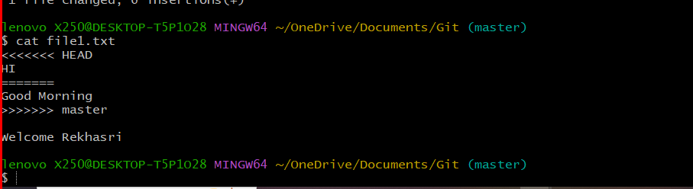
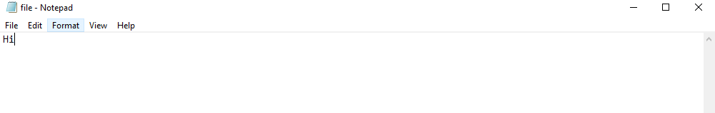
In the above process will be done with the reason when we have to merge two branches with one on one any conflict will be Occurred, in the meanwhile how to solve the conflict and how to successfully we have to merge two branches.
Let’s starts how to stash the git branches
First, we have to create one text document as file.txt in file.txt we have to some content like below image.

Slide 47
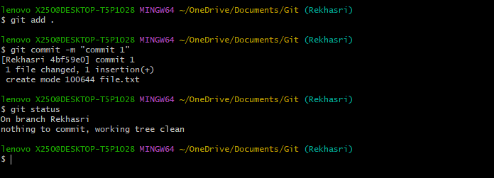

After giving the content we must have to add it to the repository by using git add . command.
After adding you must need to commit with one commit message by using git commit command.
After committing we have to check status whether it commits or not.
Again, add some content like below
After that we have to add it by using git add . command, and check the status.

Slide 48
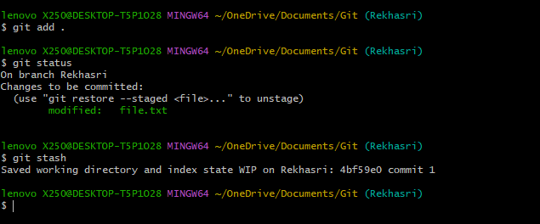
Git Stash
Git Stash: The git stash command is a useful tool in Git that allows you to temporarily save changes in your working directory without committing them.

Slide 49
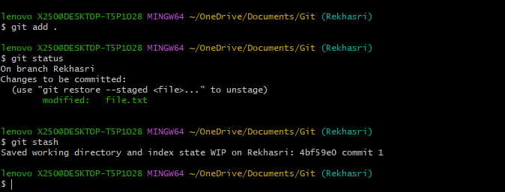
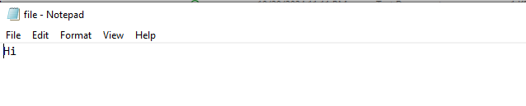
Again, we have to add some content after stashing and check status by using git add . and git status command.
Again, we have to give git stash command, after stashing “Good Morning” text will be disappeared as shown in blow image.

Slide 50
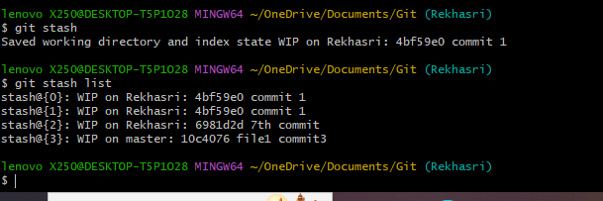
Git Stash
Git stash list: The git stash list command is used to view a list of all stashed changes in your Git repository.
Syntax: git stash list

Slide 51
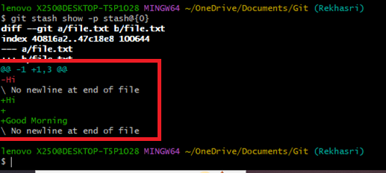
Git Stash
Git stash show -p stash@{}:The command git stash show -p stash@{} is used to display the changes contained in a specific stash entry in a detailed (patch) format. This is helpful for reviewing what changes you saved before deciding to apply or drop the stash.
Syntax: git stash show -p stash@{}

Slide 52
In above image we have seen the difference between after stashing what changes are made in the process of stashing.
Here, Red color text indicates after stashing and green color text indicates before stashing.
Git stash apply stash@{}: This command takes the changes saved in the specified stash and applies them to your current working directory.
Syntax: git stash apply stash@{}

Slide 53
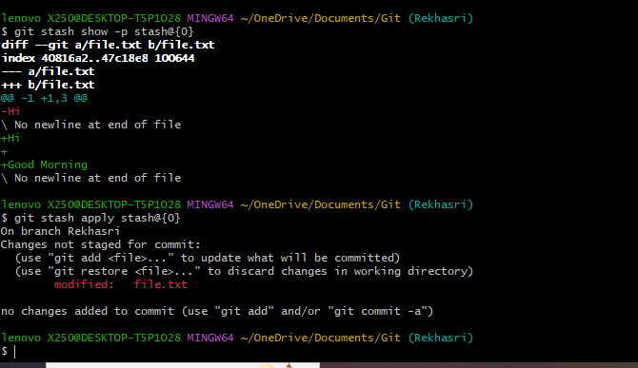
After stashing we’ll give git stash apply stash@{} command it applies what changes made in our working directory.
Syntax: git stash apply stash@{}
In the below image we have seen the difference of before stashing and after stash apply.

Slide 54
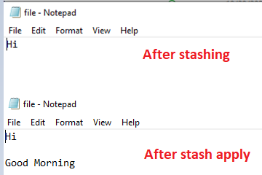
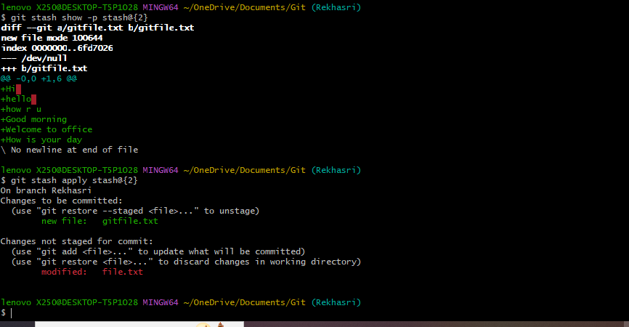
Below are the example of other stash show commands and stash apply commands.

Slide 55

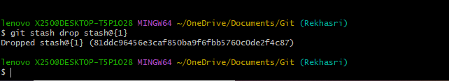
Git stash drop stash@{}: The command git stash drop stash@{} is used to remove a specific stash entry from your stash list in Git. This is useful for cleaning up your stash when you no longer need certain saved changes.
Syntax: git stash drop stash@{}

Slide 56
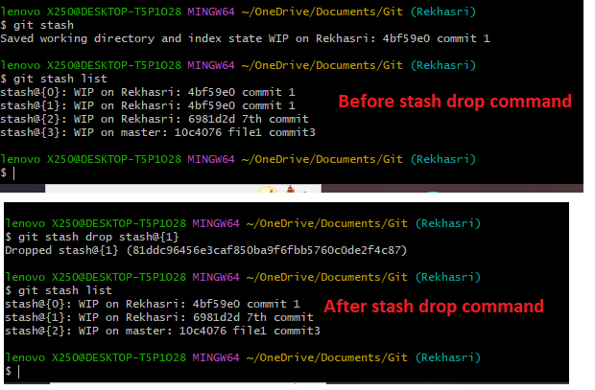
Here we have done how to stash in git and how to changes made in git repository.

Slide 57
Git Revert
Git revert: The git revert command is used to create a new commit that undoes the changes made by a previous commit. This is particularly useful for reverting changes in a safe manner without altering the project's history.
In this we have to create a new file adding some content to that file and give git add . command and commit it multiple times as your wish. In this scenario I have commit 3 commits i.e. 1st commit, 2nd commit and 3rd commit.

Slide 58
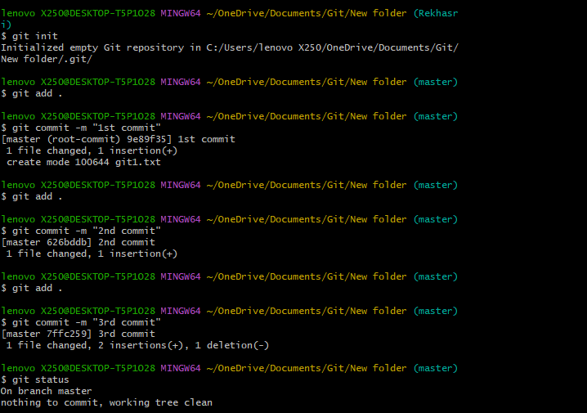

Slide 59
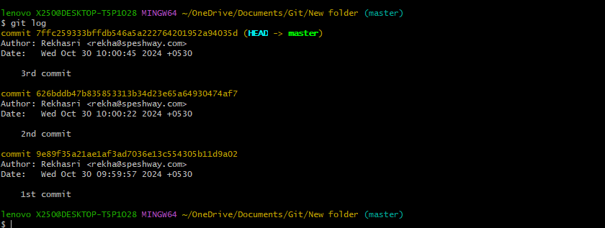
After committing all we need to check commit id’s by using git log command
After giving git log command we have seen id’s select one id in this situation I have select 2nd commit id copy that id.
Syntax: git revert <commit id>

Slide 60
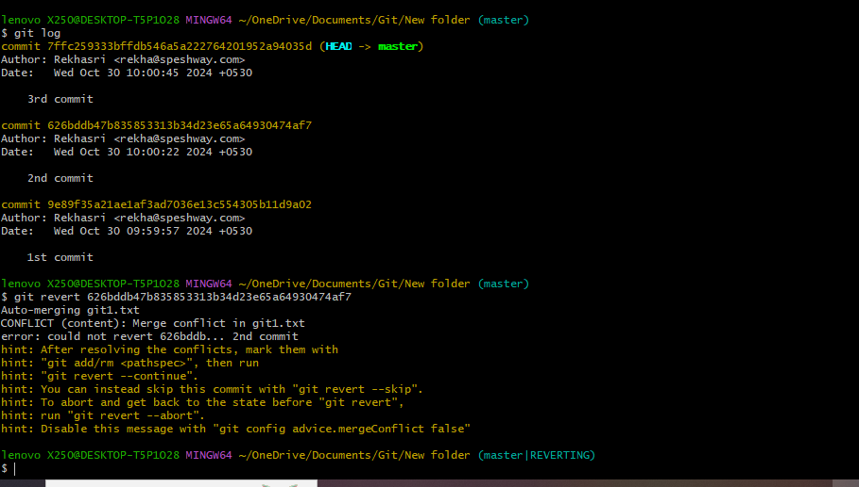
After giving git revert command one conflict will be occurred as shown in above image.
And opened an editor file as it shows which commit will be reverted in git repository as shown in below image.

Slide 61
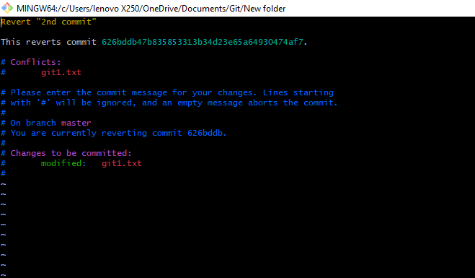
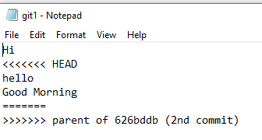
Here is the example of after reverting how it will reflect on the text document and local repository.

Slide 62
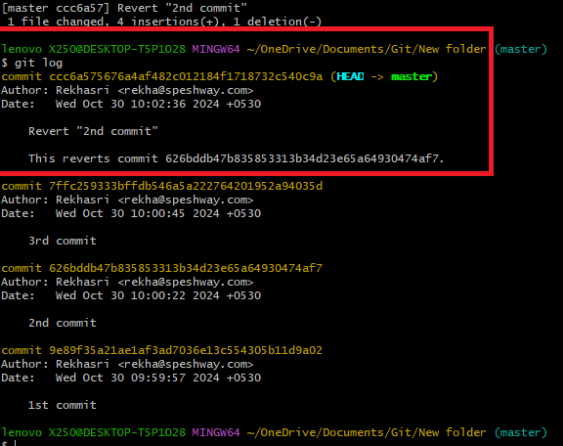
After reverting commit we have to check whether commits are reverting or not by using git log command
The above process is done on revert in git repository

